Slide 1
Introduction to Database Design
Exercises 2
02-09-2015
Some figures are taken from the ppt slides from the book
Database systems by Kiefer, Bernstein, Lewis
Copyright © 2006 Pearson, Addison-Wesley, all rights reserved.
Original version of slides by Rasmus Pagh

Slide 2
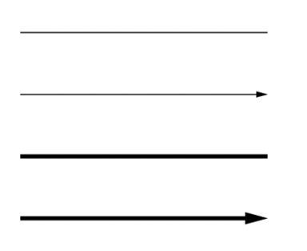
Today’s exercises
Get comfortable with the ER notation
Normal line = 0..*
Normal arrow = 0..1
Bold line = 1..*
Bold arrow = 1..1

Slide 3
Today’s exercises
We will be here in 4a14, if you have questions. We also have 4a20/4a22
Work on exercises or assignment 1
Start early!

